Slide 1
Framework to Evaluate RAG System
Evaluation using Llamaindex

Slide 2
Topic to Cover
What is RAG
Advantage of RAG
Naive RAG Pipeline
Advance RAG
RAG Evaluation
Implementation using Llamaindex

Slide 3
What is RAG
Retrieval Augmented Generation (NLP)
Information Retrieval + Text generation
The goal of RAG is to produce more accurate and contextually relevant responses in text generation tasks.

Slide 4
Advantage of RAG
Contextual Relevance - Response more contextually relevant & informative
Fact Checking and Verification - Reducing false misleading information
Improved Knowledge Incorporation - Useful in Q&A
Flexibility and Adaptability - wide range of topics & task without explicit FT
Handling Out-of-Distribution Inputs - to find relevant information (Unseen)
Controlled Content Generation - Can control by specifying sources
Reduced Bias - more balance and unbiased response

Slide 5
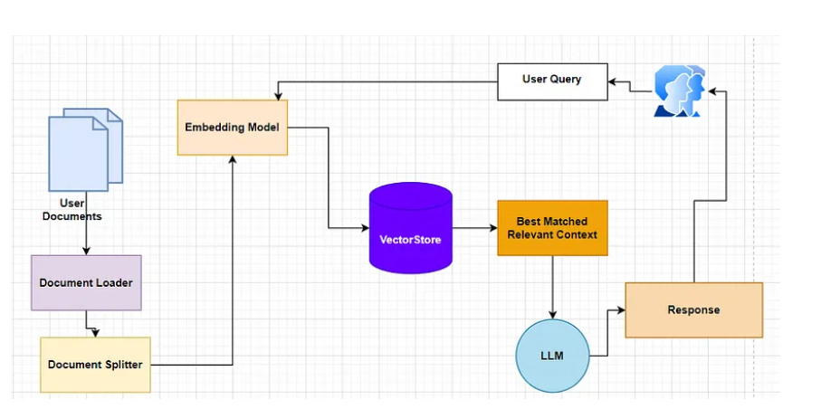
Naive RAG

Slide 6
Limitation of Naive RAG
low precision (misaligned retrieved chunks)
low recall (failure to retrieve all relevant chunks).
Redundancy and Repetition
Context Length challenges
Generation are not grounded
Potential toxicity and biases in response

Slide 7
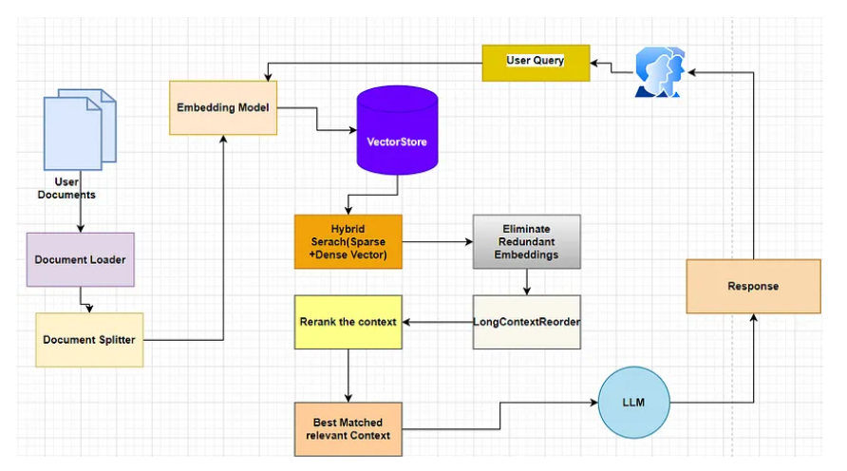
Advanced RAG

Slide 8
Evaluation of RAG
Is of high-quality content, coherent and factually correct.
Is relevant and complete
Doesn’t have lot of noise
Is not harmful, malicious and toxic
Is fast in terms of performance
Evaluation of RAG is different than LLM (HELM, OpenAI/eval, Alpaca Evaluation etc
Reference: Evaluation of RAG (Retrieval-Augmented Generation) performance (Part 5 of RAG Series) | by Chandan Durgia | Feb, 2024 | Medium

Slide 9
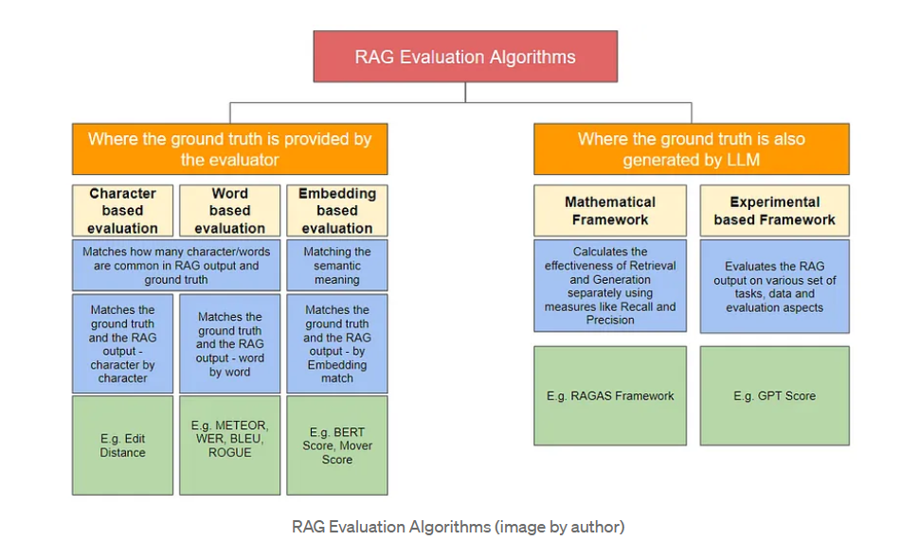
Algorithm of RAG

Slide 10
Character based evaluation
Edit Distance

Slide 11
Word based evaluation
Meteor :- Word to Word Match between RAG output and Reference
Word Error Rate:- Absolute Matching. Measure percentage of words is not matching 10% WER (means 90% Match) ex. Translation
BLEU Score :- By Matching n-grams (unigram, Bigram). Works well for short sentence ex. Translation, summarization [Bilingual Evaluation Understudy Score]
ROGUE Score:- [Recall-Oriented Understudy for Gisting Evaluation Score]
Recall = Overlapping words of RAG output / Total words in reference is summary (Ground Truth) - How accurate the translation
Precision = Number of overlapping words of RAG output / Total number of words in RAG output [ Measure relevance]
**BUT BLEU & ROGUE have relatively low correlation with human Judgement.

Slide 12
Embedding based evaluation Algorithm
Create embedding for both (Generated & Reference text)
Use distance bases measure (Cosine similarity)
BERT Score - Uses BERT Embedding - Semantic Similarity (contextual Similarity & not word similarity.)
Ex. 1) A person is sleeping with his pet cat.
2) He is resting with a cat
Also provide Precision, Recall & F1 score. Use Case - Chat
Mover Score - Earth Mover Distance, Use Case - Machine Translation, Summarization, Image captioning, Q&A etc. [Measure difference between two distribution ]

Slide 13
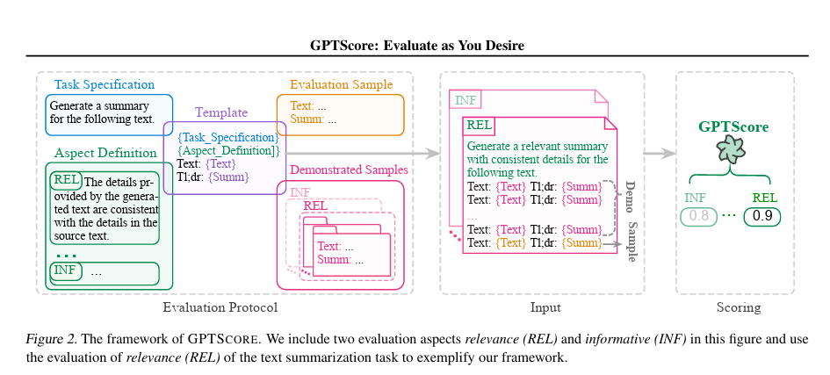
Mathematical Framework - GPT Score

Slide 14
Mathematical Framework - RAGAS
From the Retrieval perspective, it measures context Precision and Recall.
Context Precision: Precision measures the relationship between the question and the context (information source).
Context Recall: Recall measures the relationship between the context (from source) and the Ground truth i.e. can my retrieval engine extract all the
From the Generation perspective, it measures context Faithfulness and Relevancy
Faithfulness: Faithfulness captures the relationship between the Answer and the Context and gauges whether the answer is factually correct.
Answer Relevancy: This captures the relationship between Question and Answer and assesses whether the answer is relevant given the question

Slide 15
RAGAS
LLM-assisted evaluation metrics to measure the performance of application.
Monitor the performance ex. Number of Hallucination generated in the answer.
Synthetically generate a diverse test dataset

Slide 16
Reference:
Stuff: https://js.langchain.com/docs/modules/chains/document/stuff
Code: Evaluating Naive RAG and Advanced RAG pipeline using langchain v.0.1.0 and RAGAS | by Plaban Nayak | Feb, 2024 | AI Planet
Theory : Evaluation of RAG (Retrieval-Augmented Generation) performance (Part 5 of RAG Series) | by Chandan Durgia | Feb, 2024 | Medium
Hybrid Search: https://docs.pinecone.io/docs/hybrid-search
Embedding filter : https://api.python.langchain.com/en/latest/document_transformers/langchain_community.document_transformers.embeddings_redundant_filter.EmbeddingsRedundantFilter.html
Longcontextreorder:
https://python.langchain.com/docs/modules/data_connection/retrievers/long_context_reorder

